Slide 1


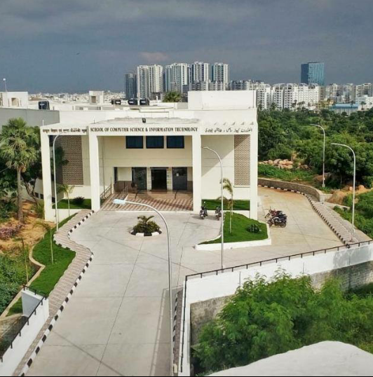
Maulana azad national urdu university
Department of CS & IT
B-tech (6th–semester)
Project-1

Slide 2

E-Commerce Website
Presented by:
Mohd Shakir (18BTCS008HY)
Mohd Zeeshan (18BTCS006HY)

Slide 3
Contents :
INTRODUCTION
FEATURES & CONTENTS
LANGUAGES & TOOLS USED
DATA FLOW DIAGRAM
ADVANTAGES DISADVANTAGES
FUTURE PLANS

Slide 4
Introduction :
E-commerce : E-commerce is the buying and selling of good or services via the internet, and the transfer of money and data to complete the sales.
For now we have used frontend web-development and tried to make the website as interactive possible by using navigation bar, in- page links, forms and other tools.

Slide 5
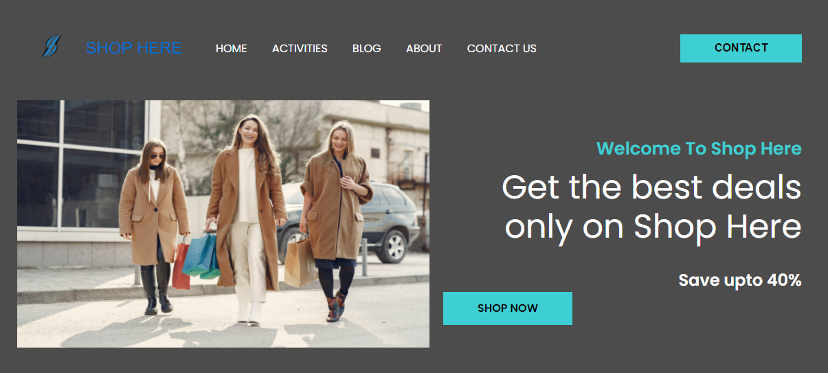
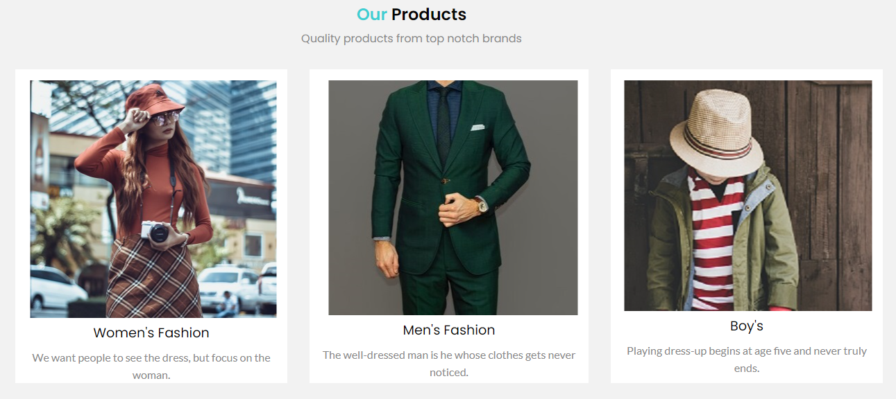
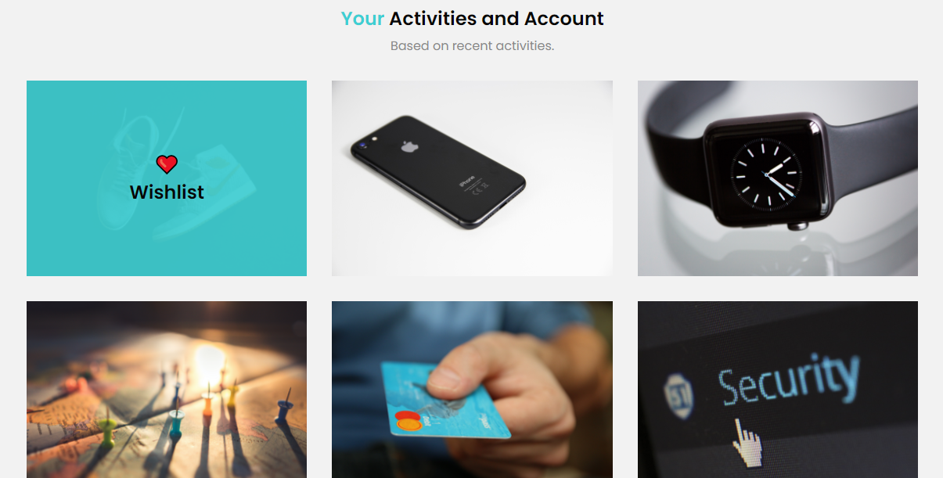
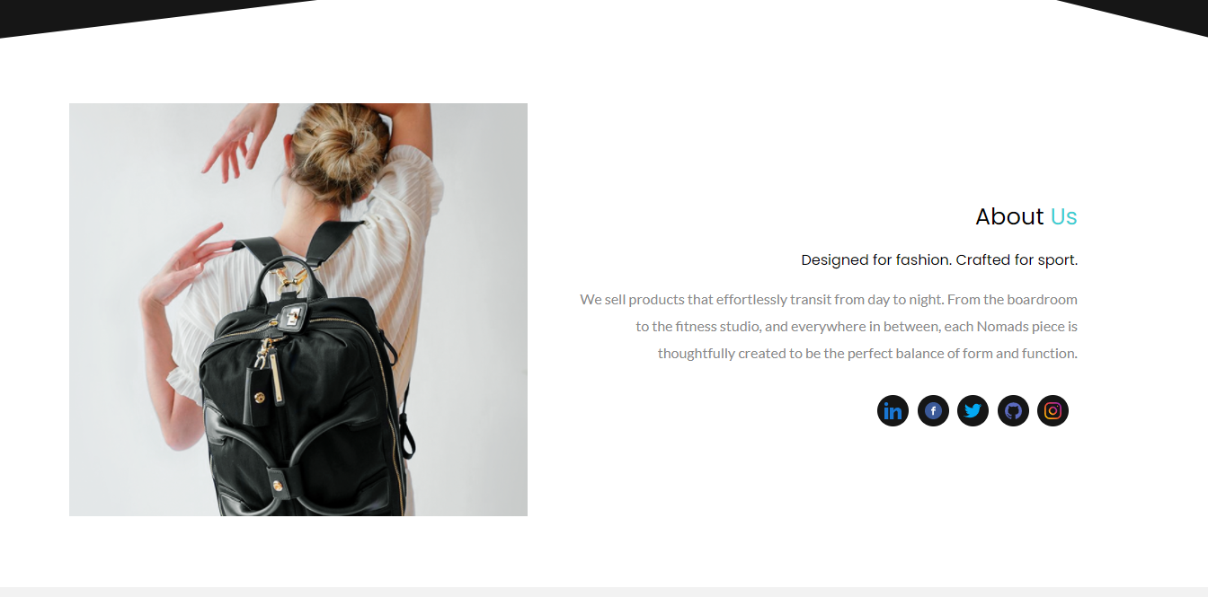
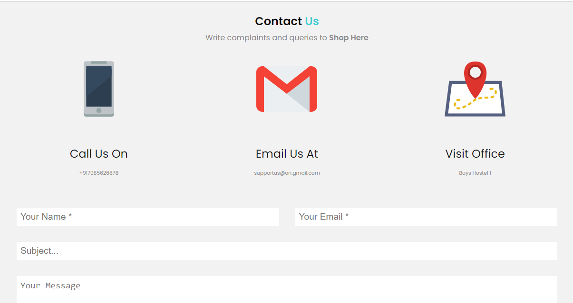
Features & Contents:
Welcome Page
Our Products Categories
Review System
Account and Activities
About Us
Contact Info
Shop Here

Slide 6
Languages & Tools Used:
HTML
CSS
JavaScript
Bootstrap
Other tools(Sliders, Fonts etc.)

Slide 7
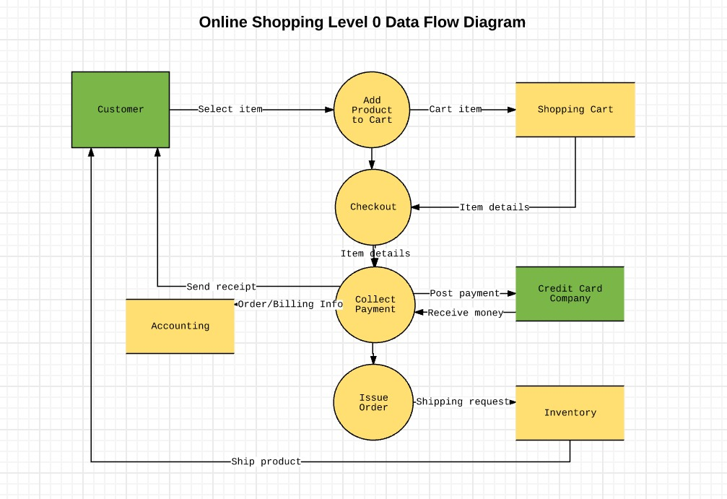

Slide 8
ADVANTAGES OF E-COMMERCE
Faster buying/selling procedure, as well as easy to find products.
Buying/selling 24/7.
More reach to customers, there is no theoretical geographic limitations.
Low operational costs and better quality of services.
No need of physical company set-ups.
Easy to start and manage a business.

Slide 9
DISADVANTAGES OF E-COMMERCE
Unable to examine products personally .
Not everyone is connected to the Internet .
There is the possibility of credit card number theft.
Mechanical failures can cause unpredictable effects on the total processes.

Slide 10
Future plan
We are thinking of some modifications and adding some advanced new features in out system. Some of them are –
Recommendations using ML Algorithms
GUI modification (more user friendly)
Users can sell their products
Users can signup / login using their social media account such as facebook , google+ etc.

Slide 11
THANK YOU!!!

